Slide 1
Sources of Noise

Slide 2
Noise
Undesired electrical signals which are introduced with a message signal during the transmission or processing are called Noise.
Noise may be predictable or unpredictable. The predictable noises can be estimated and eliminated by proper design. Eg: Power supply hum, spurious oscillations.
The unpredictable noise varies randomly with time and cannot be controlled. The amount of noise power decides the minimum power level of the desired message at the transmitter
Sources:
External noise : created outside the circuit. Includes Erratic Natural Disturbances and Man-made Noise.
Internal noise: Created by the active and passive components present within the communication circuit itself.

Slide 3
External Noises:
Erractic Noise Disturbances
This type of noise does not occur regularly. It is caused by lightning, electrical storms and other atmospheric disturbances.
This noise is unpredictable and known as atmospheric or static noise. It is less severe above 30MHz.
Man-made Noise
This noise is because of undesired pick-ups from electrical appliances such as motors, switch gears, automobile and aircraft ignitions etc.
This can be controlled and eliminated by removing the source of noise. It is effective in frequency range of 1MHz-500MHz.

Slide 4
Internal Noise:
Also known as fluctuation noise. It is caused by spontaneous fluctuations in the physical system.
Eg: (a) Thermal motion of free electrons inside resistors known as Brownian motion, which is random in nature.
(b) The random emission of electrons in vacuum tubes
(c) The random diffusion of electrons and holes in semiconductors
The fluctuation noise is very significant. Types:
Shot Noise
Thermal Noise

Slide 5
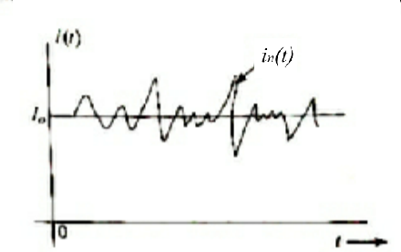
Shot Noise
Appears in active devices due to the random behaviour of charge carriers.
In electron tubes, the shot noise is generated due to random emission of electrons from cathode.
In semiconductors, it is caused due to the random diffusion of minority carriers or random generation and recombination of electrons and hole pairs.
Current in electron devices flows in the form of discrete pulses, every time a charge carrier moves from one point to other.
Although the current appears to be continuous it is still discrete phenomenon. The nature of current variation with time is shown:
The current fluctuates about mean value Io.
This current in(t) which wiggles around the mean
Value is known as Shot noise.
i(t) = Io + in(t)

Slide 6
Partition Noise:
The multigrid tubes (tetrode, pentode etc.) contain more than one grid and the partition of electrons emitted from cathode among the various grids is random in nature. This gives rise to another source of noise in multigrid tubes, called Partition Noise.
Flicker Noise:
Noise of his type arises due to imperfections in cathode surface of electron tubes and surfaces around the junctions of semiconductor devices.
Resistor Noise:
The noise arising due to random motion of free charged particles in conducting media such as resistor is called resistor noise or Johnson noise.
The intensity of random motion is proportional to thermal energy supplied, and is zero at temperature of absolute zero. This noise is also known as thermal noise.

